Slide 1


Batch - 1: crime analysis
01
2023
Presented by
ABHAY_22R21A6681
ANURAG_22R21A6680
JASMITHA_22R21A6670
VICTORIA_22R21A6672
Pitch deck
Pitch deck

Slide 2
Table of contents
01
02
03
Problem Statement
Customer Survey
Solution and Design To gather data through different sources ,segregate ,analyse, and provide data of each location .
02
20XX
to develop a predictive model that can accurately forecast the likelihood of criminal activity in a given area or location based on its crime history
Pitch deck

Slide 3
Problem Statement
03
20XX
To develop a predictive model that can accurately forecast the likelihood of criminal activity in a given area or location based on historical crime data, demographic information, and other relevant factors.
The goal is to create a model that can explain various civil & crime cases to both law enforcement and common people about an area of their choosing.
This model also explains various other problems regarding municipality ,and create awareness about a problem which failed to grab attention.
The ultimate objective is to reduce the occurrence of crimes and improve public safety.
Pitch deck

Slide 4

Customer Survey
*Crime prediction has shown promising results in helping law enforcement agencies to reduce crime rates and improve public safety in many areas.
*some cities have implemented real-time crime prediction systems that can alert officers to potential crimes in progress.
*While crime prediction is not a perfect solution and must be used in conjunction with other crime prevention strategies, it has shown potential in reducing crime rates and improving public safety in many areas.

Slide 5
Problem and solution
05
20XX
Problem
Solution
"Forecast crime likelihood, aid law enforcement, and enhance public safety."
To gather data through different sources ,segregate ,analyse, and provide data of each location .
Pitch deck

Slide 6
Exisisting Solutions
06
20xx
Solution 1
Solution 2
ShotSpotter - a gunshot detection system that uses acoustic sensors to detect and locate gunfire, providing real-time information to law enforcement.
CrimeRadar - a mobile app that uses machine learning and geolocation data to predict and notify users of potential crime in their area.
Pitch Deck

Slide 7
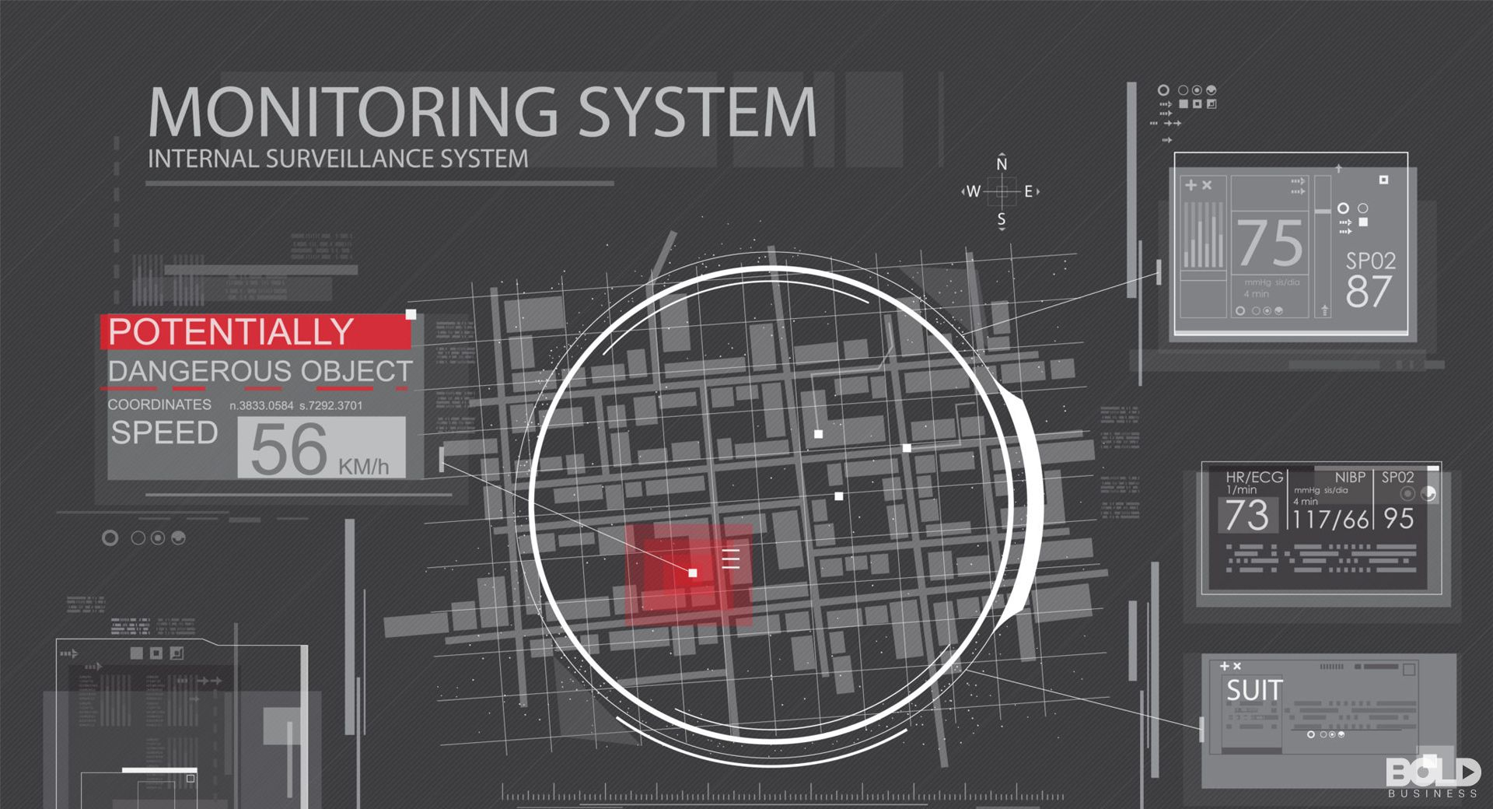
Product Overview
07
20xx
Crime prediction products use machine learning algorithms and statistical analysis to identify patterns and trends in historical crime data and other relevant factors, such as demographic information and weather conditions. By analyzing these data points, crime prediction products can provide law enforcement agencies with insights and forecasts on potential criminal activity in specific locations and times, allowing them to take proactive measures to prevent crime and improve public safety.
Overall, crime prediction products aim to assist law enforcement agencies in their efforts to prevent crime and improve public safety by providing them with data-driven insights and actionable information. By identifying crime hotspots and potential criminal activity before it occurs, crime prediction products can help reduce crime rates and enhance public safety in the communities they serve.

Slide 8
SWOT Analysis
08
Improved public safety
Efficient resource allocation
Data-driven insights
Real-time information
Enhanced collaboration
Collaboration with community organizations and stakeholders can enhance crime prevention efforts
Integration with other public safety systems, such as emergency response services, can improve overall public safety
Opportunities
Strengths
Weakness
Threats
Limited accuracy
Possible bias in data and algorithms
Privacy concerns with real-time surveillance technology
High costs associated with developing and implementing
Possible legal and ethical challenges related to the use of real-time surveillance technology and predictive algorithms
Public skepticism or distrust of crime prediction systems, which can limit their effectiveness

Slide 9
Value proposition (Product)
Gain creators
We can monetise the information we are selling by handling it over in subscription model ,which can help both civilians and law enforcement
Products and services
Data collection:
Predictive analytics
Crime mapping
Real-time monitoring
Risk assessment
Collaboration tools
Reporting and alerts
Pain relievers
Addressing bias: Crime prediction systems should be developed with a focus on fairness, transparency, and accountability. Algorithms should be regularly audited for biases, and data should be carefully selected and screened to avoid discriminatory practices

Slide 10
Value proposition (Customers)
Gains
The customer gains from a crime prediction system can include improved public safety, increased efficiency in law enforcement, data-driven decision-making, and stronger community-police relations.
Customer jobs
Enhancing public safety
Improving the efficiency of law enforcement agencies
Promoting community-police relations
Supporting evidence-based decision-making
Pains
A crime prediction system aims to alleviate the pain of ineffective crime prevention by providing law enforcement agencies with data-driven insights to prevent crime before it occurs.

Slide 11
Design Blueprint
09
Data collection: Collect data from various sources, such as crime reports, arrest records, and incident reports.
Data preprocessing: Clean, transform, and preprocess the collected data to prepare it for analysis.
Feature engineering: Select and engineer relevant features from the preprocessed data that can be used to identify patterns and trends in criminal activity.
Machine learning: Use machine learning algorithms, such as regression, decision trees, and neural networks, to build a predictive model based on the selected features.
Model evaluation: Evaluate the performance of the predictive model on a validation dataset to assess its accuracy, precision, recall, and other relevant metrics.
Model deployment: Deploy the predictive model in a production environment, such as a web application or a mobile app, that can be used by law enforcement agencies to predict and prevent crime.
Continuous monitoring and improvement: Monitor the performance of the predictive model in real-time, collect feedback from users, and continuously improve the model to ensure its accuracy and effectiveness in predicting and preventing crime.
20XX

Slide 12
limitations
09
In 7 week of time, we can design a complete website ,but the location and information it can cover will be limited to the available data sources and also a few errors can be expected in the course of prediction work
Since we are planning to cover criminal and civil cases included with sections and laws of court and also the data which covers the current political affairs and events
The prediction which is the core idea ,will also be used to predict several other points
Going forward
We can give prediction for an entire state or country ,depending on time .and also we can cover other areas of crime i.e. cyber crime etc..
We can gather large data sets of various information from trusted sources and can also include opinions of people in site or from various other sites including social media.
We can cover and give other sort of prediction like political pridictions.
20XX

Slide 13
Thank You!
Do you have any questions?
Presented by
ABHAY_22R21A6681
ANURAG_22R21A6680
JASMITHA_22R21A6670
VICTORIA_22R21A6672

